Slide 1
Disk Partitions
Logical section of a hard disk on which the computer can write data
Partitions offer a way to divide the space on a single physical hard disk into multiple areas
Each of which is treated as a different disk within Windows

Slide 2
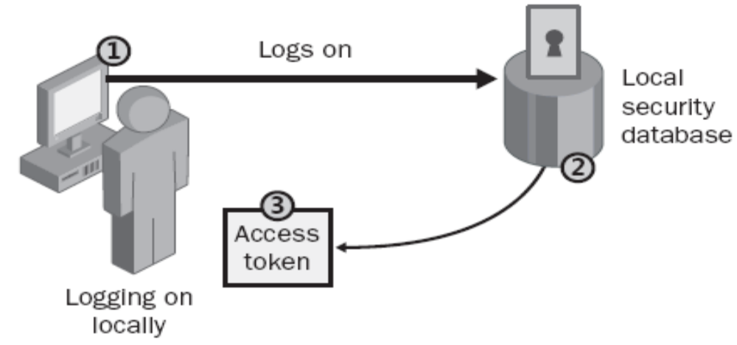
Authentication Process
To gain access to a computer running Windows XP Professional or to any resource on that computer must provide a user name and possibly a password

Slide 3
Authentication Process
The steps in the authentication process are as follows:
  1. The user logs on by providing logon credentials—typically user name and password, and Windows XP Professional forwards this information to the local security system of that local computer
  2. Windows XP Professional compares the logon credentials with the user information in the local security database

Slide 4
Authentication Process
3. If the credentials are valid, Windows XP Professional creates an “access token” for the user, which is the user’s identification for that local computer. The access token contains the user’s security settings, which allow the user to gain access to the appropriate resources on that computer and to perform specific system tasks.

Slide 5
User Accounts
A user logs on to a computer or a network by supplying a user name and password that identify that user’s user account
Without a user account, a user cannot log on to a computer, server, or network
Two types of user accounts
  local user account
  domain user account
On Windows 7/xp computers, you can create local user accounts
If your network has a Windows Server 2008, Windows Server 2003, or Windows Server 2000 domain controller, your network can have domain user accounts as well

Slide 6
User Accounts
Local user account
  Allows you to log on to a specific computer to access resources on that computer
  Windows 7 creates the account only in that computer’s security database, called the local security database
  Provide access to resources on the local computer
  Use local user accounts only on computers in work-groups

Slide 7
User Accounts
Local user accounts has further types
Account Types
  Administrator
    The administrator account type provides unrestricted access for performing administrative tasks
    Only administrator accounts can change the Registry
    Can create other user accounts

Slide 8
User Accounts
Standard User
  The standard user account type should be assigned to every user of the computer
  Standard user accounts can perform most day - to - day tasks, such as running Microsoft Word, accessing email, using Internet Explorer, and so on
Built - in Accounts
  Built - in accounts are accounts that are created at the time you install the Windows 7 operating system

Slide 9
User Accounts
Administrator
  The Administrator account is a special account that has full control over the computer
  The Administrator account can perform all tasks, such as creating users and groups, managing the file system, and setting up printing

Slide 10
User Accounts
Guest
  The Guest account allows users to access the computer even if they do not have a unique username and password.
  Guest account is disabled by default
Initial user
  The initial user account uses the name of the registered user. By default, the initial user is a member of the Administrators group

Slide 11
User Accounts
HomeGroup user
  The HomeGroup user is created by default to allow this machine to connect to other machines within the same HomeGroup network

Slide 12
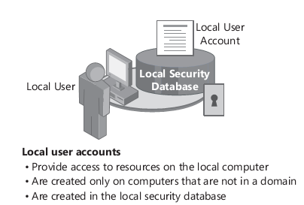
User Accounts

Slide 13
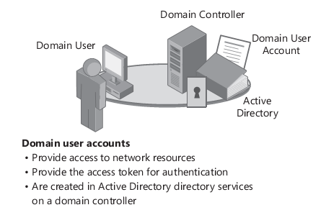
User Accounts

Slide 14
Groups
A group is a collection of user accounts
Groups simplify administration by allowing to assign permissions and rights to a group of users rather than to each user account individually
Permissions control what users can do with a resource such as a folder, a file, or other resources

Slide 15
Groups
When assign permissions, allow users to gain access to a resource
If several users need to read the same file, you can add their user accounts to a group and then give the group permission to read the file
Rights allow users to perform system tasks such as restore file, backup of file

Slide 16
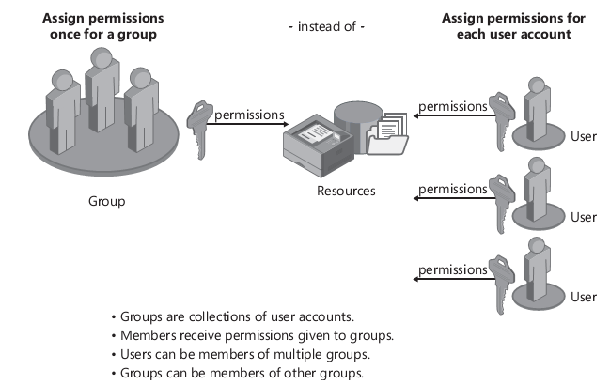
Groups

